Slide 1
The Power of context

Slide 2
Published media provides brands with meaningful connections to consumers via a distinctive context
Consumer
Context
ˈkɒntɛkst/
the circumstances that form the setting for an event, statement, or idea, and in terms of which it can be fully understood.
Context is multi-layered, it is not just about where advertising is placed. The relationship consumers have with published media results in a distinctive mindset, which influences how advertising is consumed. Equally the dynamic that exists between published media and the advertising environment hindered by adblocking, this context provides a compelling opportunity for advertisers who want to meaningfully connect with consumers.
Published media
Advertising

Slide 3
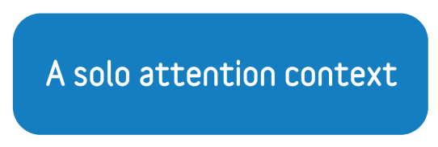
In a multi-screening world consumers still prepared to give published media solo attention
Readers don’t consume any other media at the same time
Newspapers
Magazines
60%
58%
Source: Newsworks/PwC, The battle for attention 2016

Slide 4
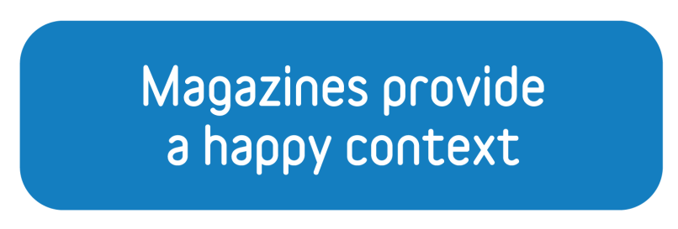
Magazine and social media differ in terms of moodstate and this effects receptivity to ads
+6%
Positive shift in subjective wellbeing while consuming magazine content
24%
Are more receptive to content when they are UPBEAT
Source: Yahoo receptivity of emotions 2017
Source: Magnetic/ Join The Dots,
Moments that Matter 2015
Actions on social media* associated
with a decrease of 5-8% in self-reported mental health.
(*clicking on a link, updating one’s status, or clicking ‘like’)
Source: University of California and Yale University – Facebook makes people less happy https://www.indy100.com/article/facebook-study-worse-bad-health-well-being-negative-ucsd-yale-8017266

Slide 5
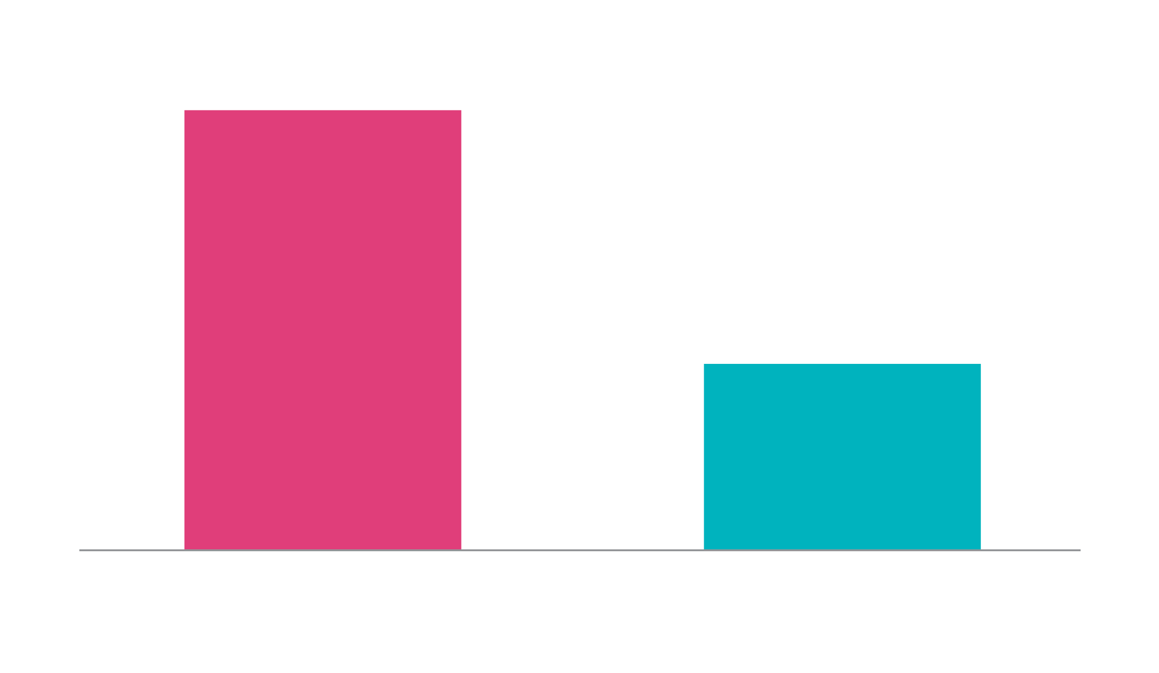
Magazines provide a trusted context
To what extent do you trust the information provided by the above brand?
I trust the information they provide completely’ + ‘I slightly trust the information they provide’
Base sample size of trust statements section: Mag readers – 2484, Social Media – 654.
Source: Matter of Trust

Slide 6
A trusted magazine context delivers uplifts in brand KPIs
94%
64%
Average % uplift in
Brand trust metrics
Source: Matter of Trust

Slide 7
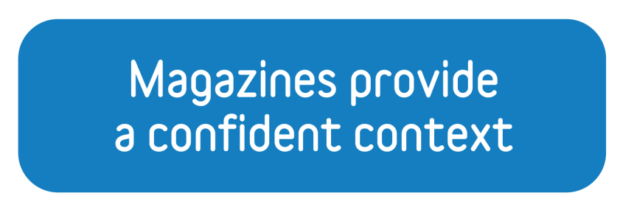
A confident mindset whilst reading a magazine, translates to confidence in brands advertised there
Magazines are 77% more critical to building confidence
in products than social media
% Top 2 box agreement
Readers 20% more likely
to be feeling confident whilst reading printed magazines
or newsbrands
Makes me more confidents about buying products featured or advertised here
Source: IPA Touchpoints
Average excluding magazines: 36%
Source: Magazine Networks Australia

Slide 8
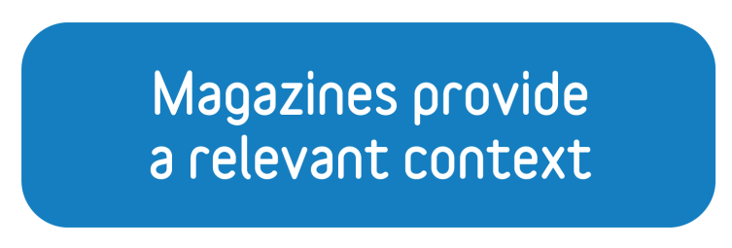
A magazine context enables brands to achieve relevancy
1.
2.
3.
Magazine Brands
TV
Social
Source: Metrics That Matter- Ability to drive uplifts in brand relevancy

Slide 9
Quality editorial context delivers uplifts in brand KPIs
3X
72%
26%
the lift in
emotional resonance
the lift in
ad recall
more positive
emotional resonance
Source: Yahoo Ad environments: The Halo Effect

Slide 10
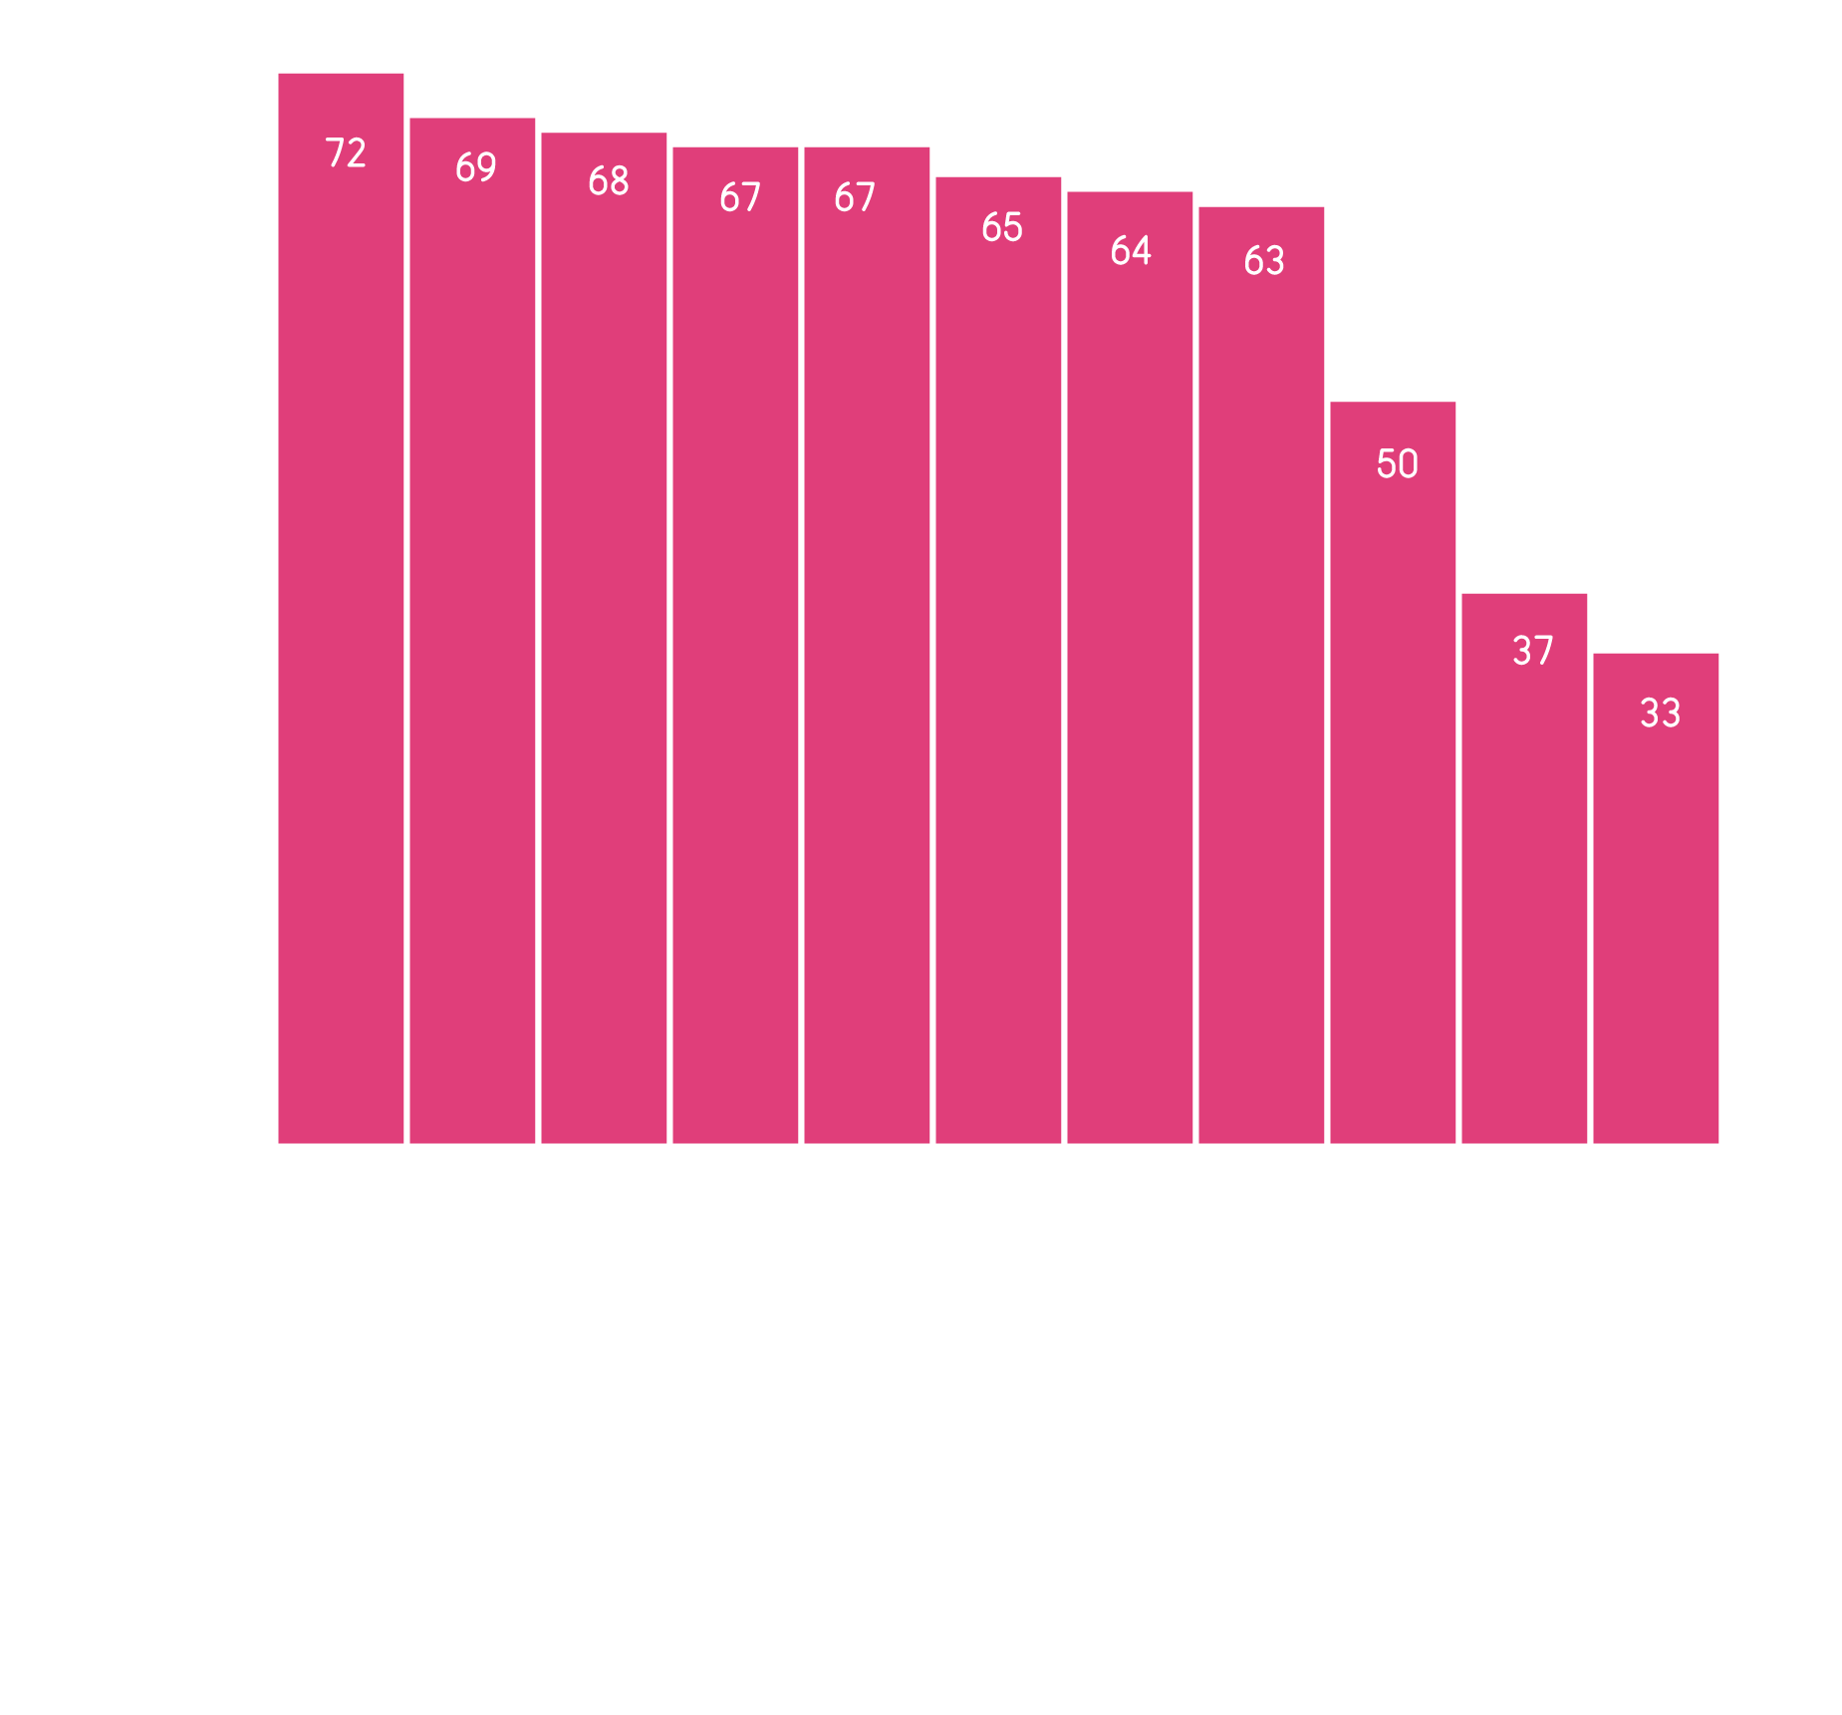
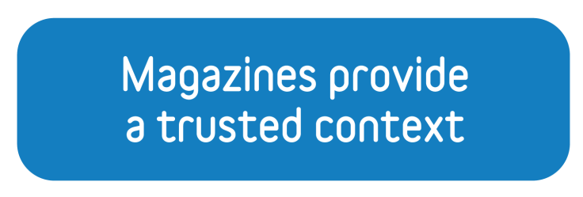
Magazines are the most trusted context for news
Source: Kantar Trust in News

Slide 11
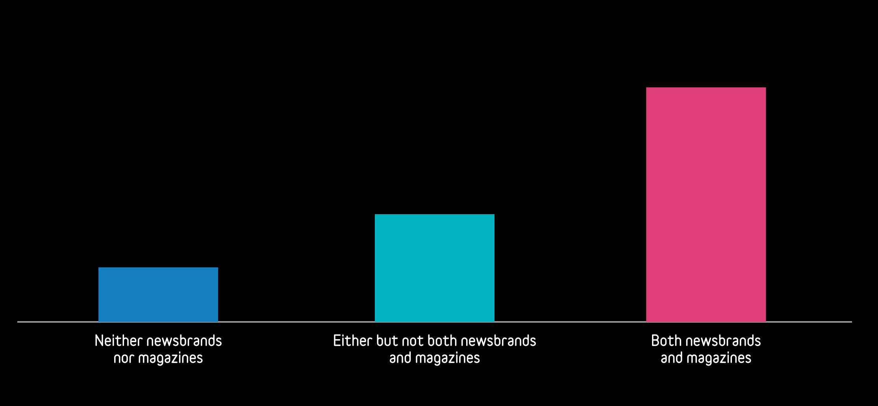
Published media facilitate discovery and enable brands to acquire new customers
% of cases reporting very large customer acquisition effects
54%
25%
13%
Source: Peter Field, IPA Databank 2012-2016 UK cases

Slide 12
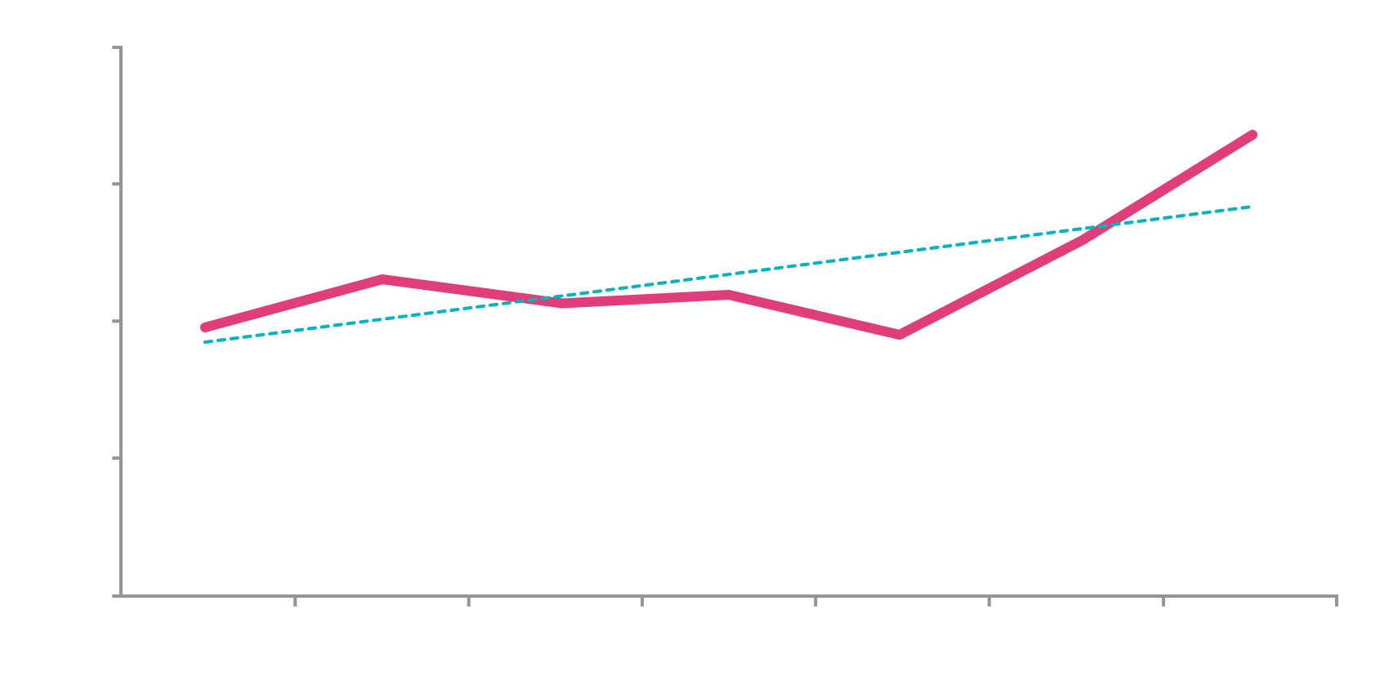
Published media are becoming more effective at delivering new customers
Uplift to very large customer acquisition effects from adding print %
Six years ending
Source: Peter Field, IPA Databank 2012-2016 UK cases

